Slide 1
From Tamsui to North America:
Inspirational Transformations of Mackay‘s Mission for Taiwanese-American Churches
~~Cross-generational Thinking to Bridge Generational Gaps, Language Barriers, and Shortages of Pastors
Tsai, Wei Min
President of Taiwan Graduate School of Theology

Slide 2
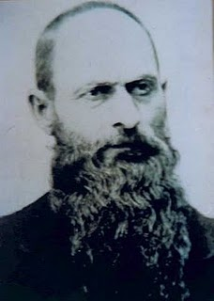
the Beginning of the Northern Mission
The late Qing Dynasty (the latter half of the 19th century) was a pivotal period when the cultural center of the entire island gradually shifted to Taipei.
On March 9, 1872, Mackay arrived in Hobe (Tamsui), accompanied by Reverend Hugh Ritchie. This day marks the anniversary of the establishment of the church in Northern Taiwan.

Slide 3
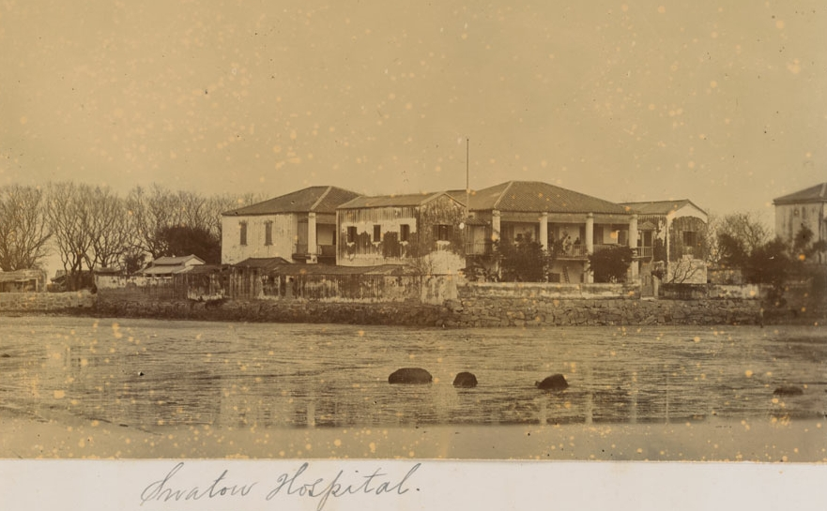
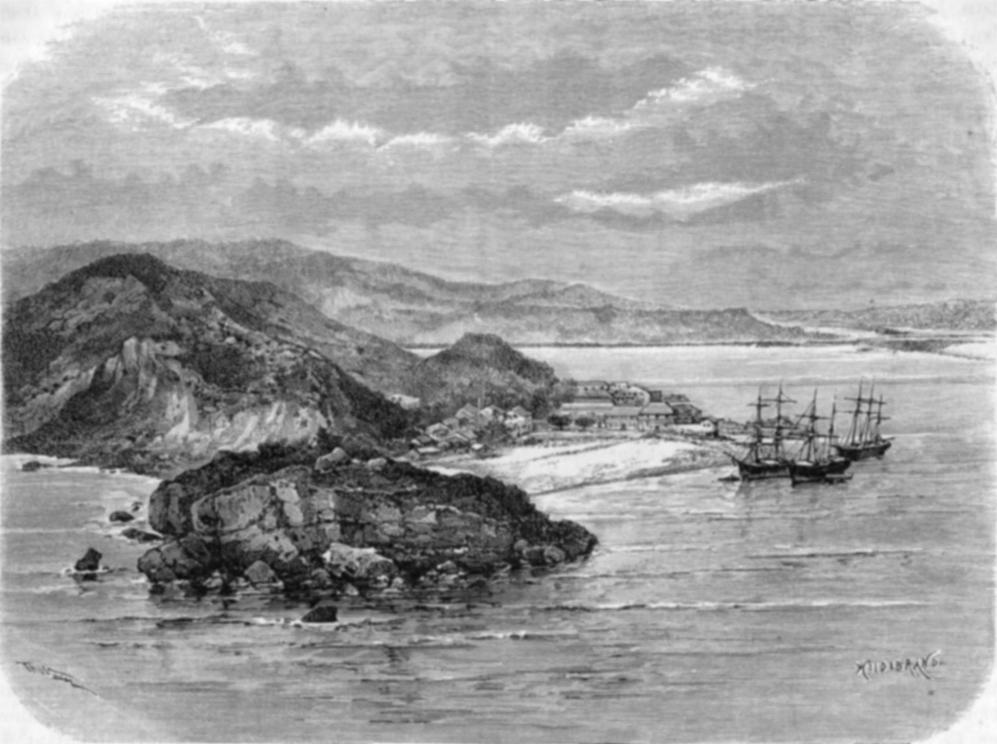
Learning with humility and integrating into local culture
Mackay arrived in Shantou in late 1871, where he preached and distributed medicine.
Subsequently, he stayed in Kaohsiung for over three months, accompanying Reverend Hugh Ritchie on itinerant preaching tours and learning the local language.
This period of apprenticeship laid the foundation for his later work in training assistants and opening a medical clinic.
Shantou
Takow (Kaohsiung)

Slide 4
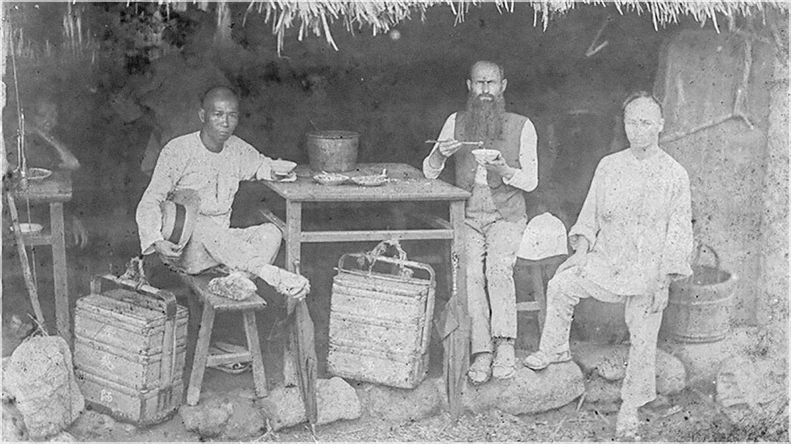
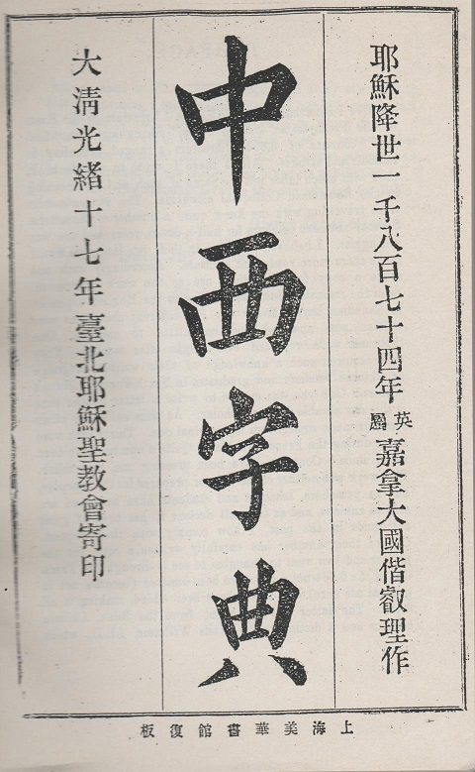
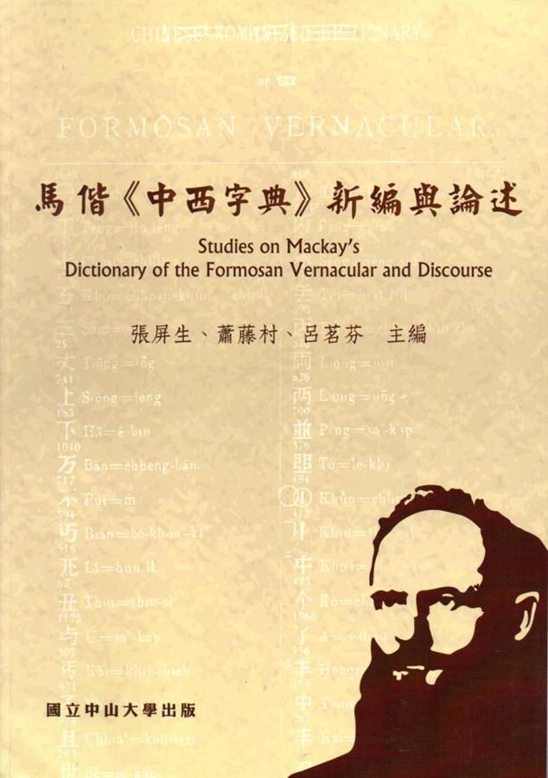
Breaking Down the High Walls of Language and Truth
Upon arriving in 滬尾 (Tamsui) on March 9, 1872, Mackay faced challenges and opposition from Non-Christian religions. However, he refuted their skepticism through solid theological debates.
He studied the language diligently. Just five months after arriving in Taiwan, he delivered his first sermon in Taiwanese.
Later, he compiled a Chinese-English Dictionary containing 9,451 words, completely breaking through cultural barriers.

Slide 5
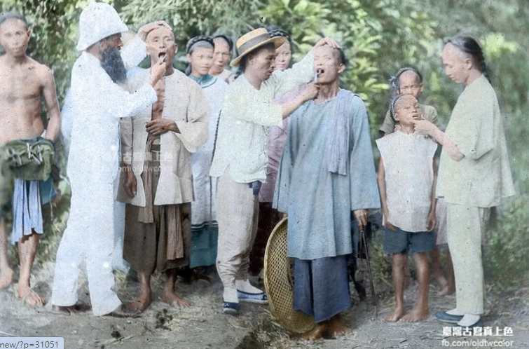
Medical Missions: Engaging Life Through Christ's Grace
Mackay initially practiced medicine using his residence as a clinic.。
When he led his disciples to the countryside to preach, he would first sing hymns in the temple square to draw a crowd, and then build trust by extracting teeth for the villagers.
He introduced "White Medicine"—a highly effective treatment for malaria, and promoted the importance of environmental hygiene, putting Christ's love into practice by improving people's living conditions.

Slide 6
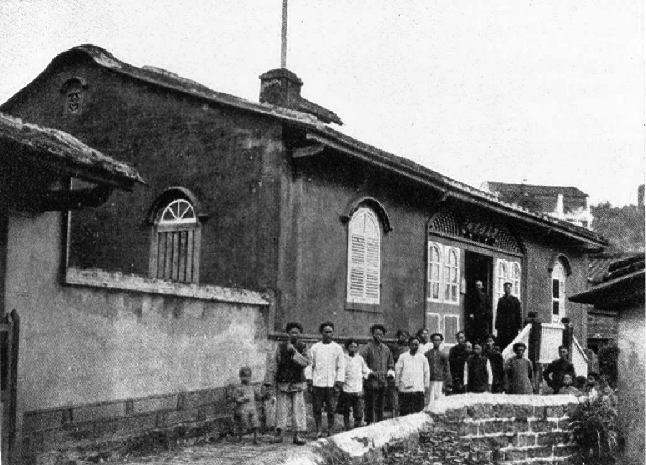
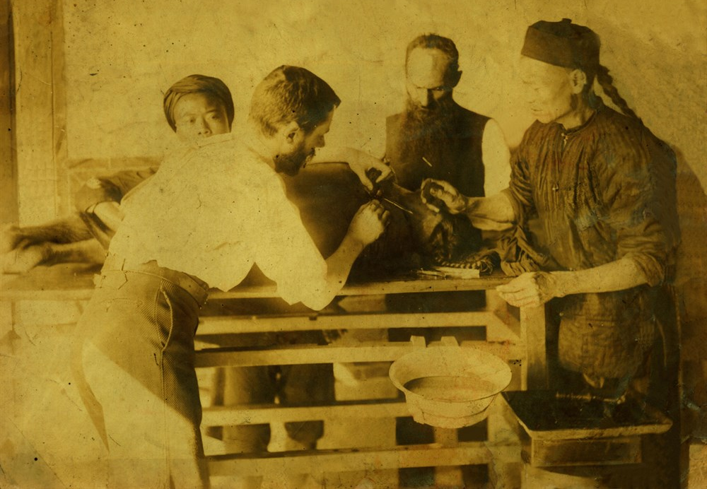
The Establishment and Social Witness of the Mackay Clinic
In 1879, with a donation of $3,000 from the widow of Captain Mackay of Detroit, the Hobe Mackay Clinic—the precursor to modern medicine in northern Taiwan—was officially established。
When the Sino-French War broke out, Mackay Clinic received public commendation from Liu Mingchuan, the Governor of Taiwan, for its voluntary assistance in treating large numbers of wounded soldiers.

Slide 7
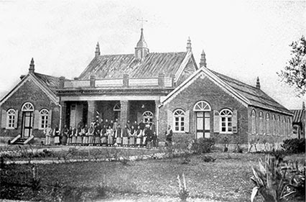
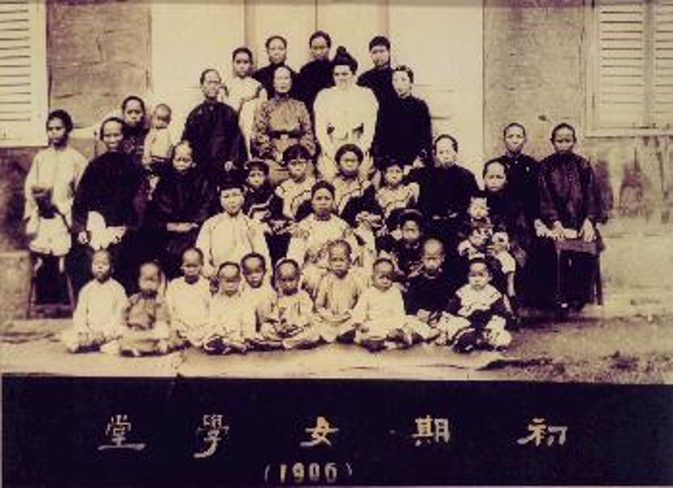
Education and Ministry: The Practice of Bi-vocational Ministry and Talent Development
In 1882, Mackay established Oxford College, implementing a holistic education program to train local preachers.
Students studied theology and general subjects at the college before noon; in the afternoon, they went to Mackay Clinic for a medical internship; and practiced preaching and engaged in in-depth review in the evening.
In 1883, Mackay founded the "Girls' School", offering room, board, and travel expenses to encourage women to receive a modern education.

Slide 8
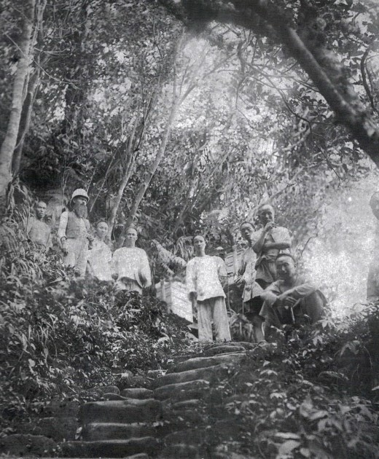
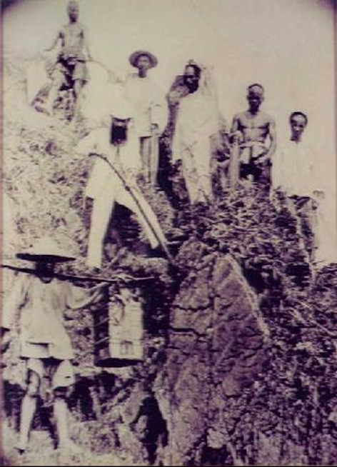
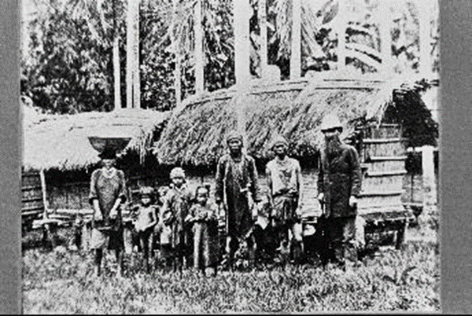
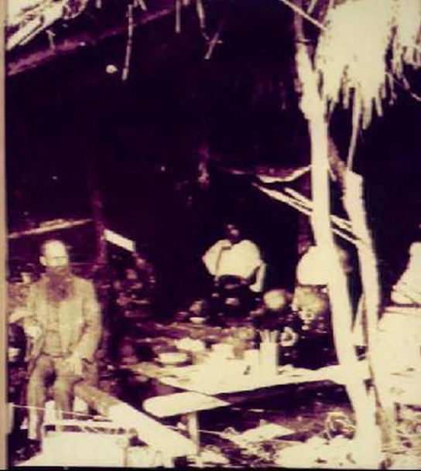
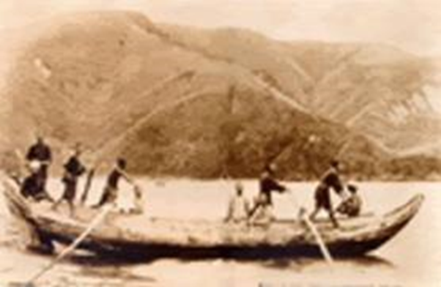
Mackay's Missionary Work
馬偕與噶瑪蘭原住民
馬偕從南方澳出海去花蓮
馬偕與學生走過淡蘭古道頭城段
馬偕與學生走過淡蘭古道三貂角
馬偕在路邊茶肆小憩

Slide 9
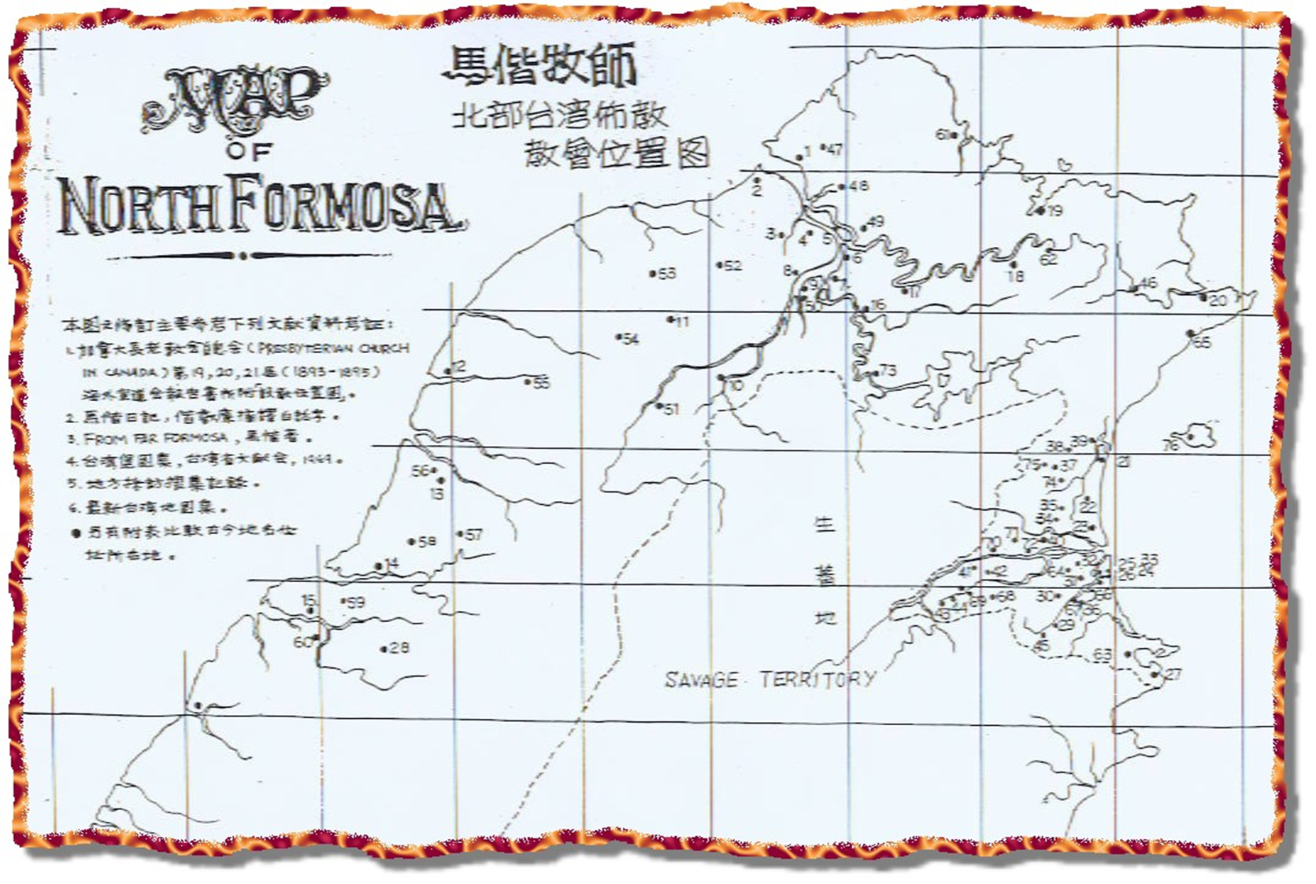

Mackay's Missionary Attitude
Absolutely will not discouragement－－Missionary zeal outstrips judgment.。
Winning the goodwill of intellectuals and local officials。
The Missionary Principle of Continuous "Travel"。
馬偕牧師的宣教是北部→客庄→東部，如此不斷來回進行醫療宣教。

Slide 10
Mackay’s Mission in Taiwan and the Mission of Taiwanese-American Churches
比較項目 | 馬偕（加拿大長老教會）在台宣教 | 美國台灣人教會（台美教會界）宣教
歷史時期 | 19世紀末期（清末，1872年抵台） | 20世紀中後期至現代
宣教主體 | 外國宣教師進入異文化 （西方人 → 台灣人） | 海外台灣移民在異鄉建立，再反哺台灣 （台僑 → 同鄉 / 本土）
核心目標 | 福音拓荒、醫療服務與基礎教育 | 鄉親凝聚、母語文化（台語）傳承、關懷台灣民主與人權
宣教策略 | 「徒步旅行佈道」、張貼十誡、建立「自立、自養、自傳」的本地教會 | 設立「同鄉會型」教會、結合台語禮拜、透過社團聯誼網絡連結海外台僑
文化適應 | 福音本地化（本色化）：馬偕娶台灣女子為妻，認同在地生活方式（融入台灣人而非要求對方變西方人） | 雙文化張力：在美國多元社會中抵抗同化，致力保存台灣語言與文化認同，並面對年輕世代的傳承斷層
社會影響 | 創立北台灣第一所西式學校（牛津學堂） 與第一間西式醫院（滬尾偕醫館） | 在海外聲援台灣民主運動（如1970-80年代對台灣人權宣言的海外支持）

Slide 11
美國台灣人教會宣教之困難與問題
Generational Turnover and the Disruption of Language and Culture
語言隔閡：台(華)語vs英語─信仰文化傳承困難。
世界觀衝突：年輕人容易流失或轉往美國主流教會
There is a severe shortage of pastoral personnel.
台語牧者凋零。
接班斷層：教會，難以提供具競爭力的薪資與福利來聘請全職青年牧師或英語堂牧者
The Challenges of Mission Transformation
過去台灣人教會在海外推動台灣民主化及人權運動，如今須轉型為「社區宣教」的挑戰。
社區融合困難：部分教會過度封閉於同溫層，缺乏向外走入社區（Outreach）的動力。
Shifts in migration patterns
過去台灣留學潮與移民潮趨緩，且新一代台灣移民多半具備全球化背景或高社經地位，他們對傳統鄉土情感的「台灣人教會」需求降低，更傾向選擇大型的跨族裔美國教會。

Slide 12
From "Being a Guest" to "Identification": Bridging the Intergenerational Cultural Divide
 | Mackay's approach | Lessons from the Taiwanese Church
Proactively learn the language of the next generation | Mackay learned Taiwanese from cowherds. | The first generation of elders must step into the English-speaking, postmodern world of the second generation.
Putting down roots rather than merely being a sojourner | Mackay married a Taiwanese woman and declared Taiwan his "final home“. | North American churches need to help young people establish a dual identity that combines their Taiwanese heritage with their local American context.

Slide 13
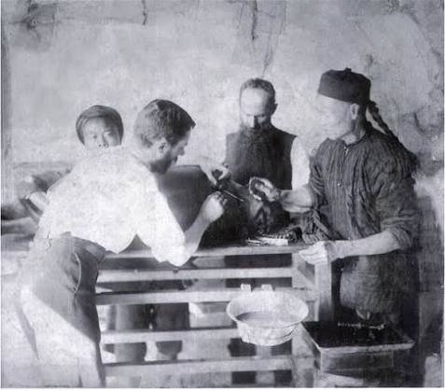
Emphasizing Local Leadership (NATIVE MINISTRY): Resolving the Shortage of Pastors
Breaking the mold
Training the first local pastor through Oxford College
Breaking the reliance on hiring pastors from overseas
Churches in North America should move beyond the mindset of "returning to Taiwan to find a pastor."
Ordain local young people
Identify and cultivate leaders among today's American youth

Slide 14

The Practice of "Bicultural Pastoral Theology"
The Third Space：Creating a "third culture" in Christ that blends Taiwan and the United States.
Double Marginalization：Transforming the "sense of marginality"—belonging neither to traditional Taiwan nor entirely to the American mainstream—into a "gift of bridging" for cross-cultural mission.。
The Shift in Theological Reflection: From "Guardians of the Homeland" to "Pilgrims of the Kingdom of God"。
Incarnation＆Border-Crossing

Slide 15

Holistic Mission :
Breaking Out of Closed Echo Chambers
Addressing the needs of neighbors through tangible services
Shifting from "Self-Preservation" to "Community Mission"
Engage in local public affairs and reshape public values.

Slide 16
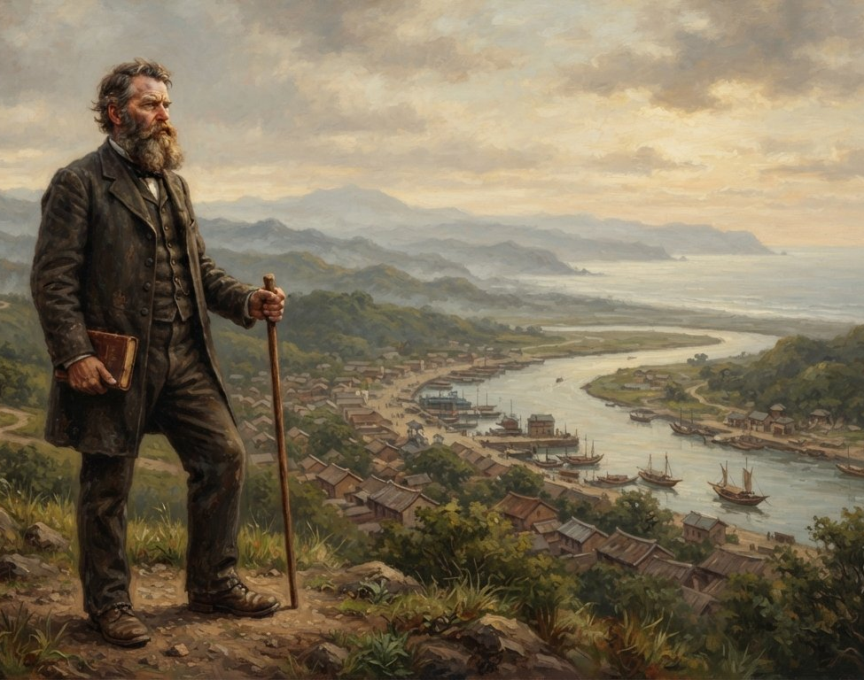
Kingdom Vision: Rather Burn Out Than Rust Out
• Mission as the Sole Core: Do not waste resources on maintaining aging, overlapping traditional congregational structures.
• Kingdom-mindedness: Possess the courage to step out of comfort zones at any time and expand into unknown mainstream American/multicultural communities.
• Relocating continuously in the face of challenges:

Slide 17
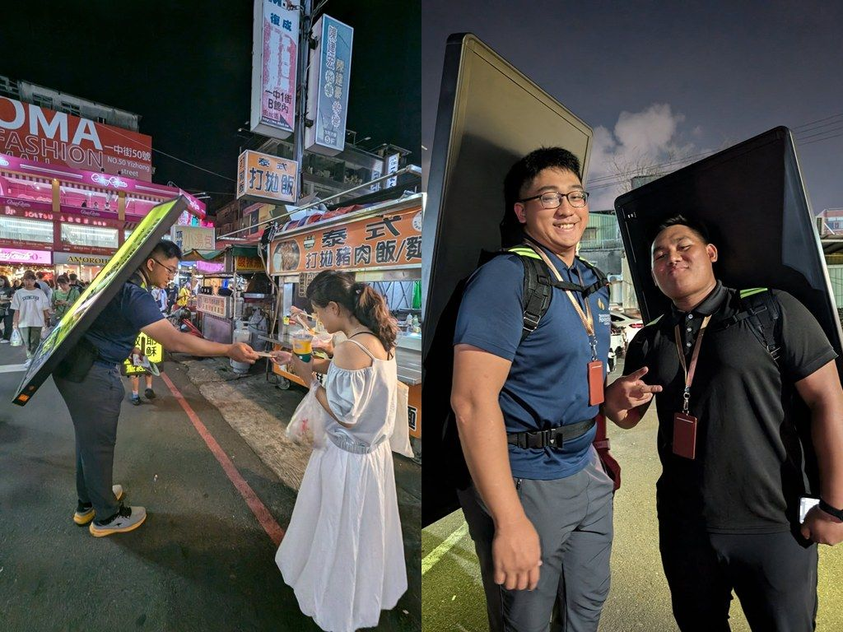
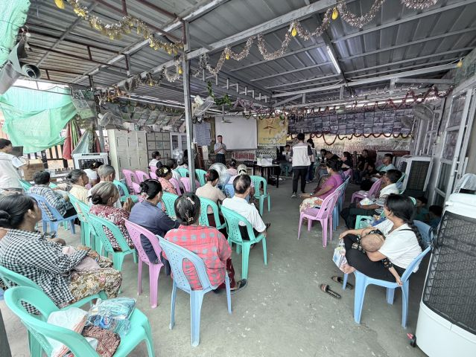
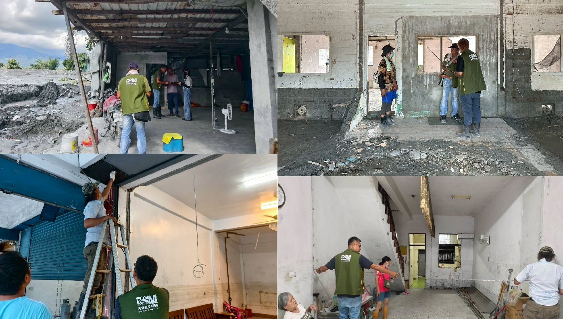
台神的作為與異象
推動在地宣教。關心台灣原住民族、新住民、移工等在地文化宣教。
海外緬甸短宣、馬來西亞海民跨文化服事
與芥菜種會合作，協助台灣社會災難救助與諮商心靈

Slide 18
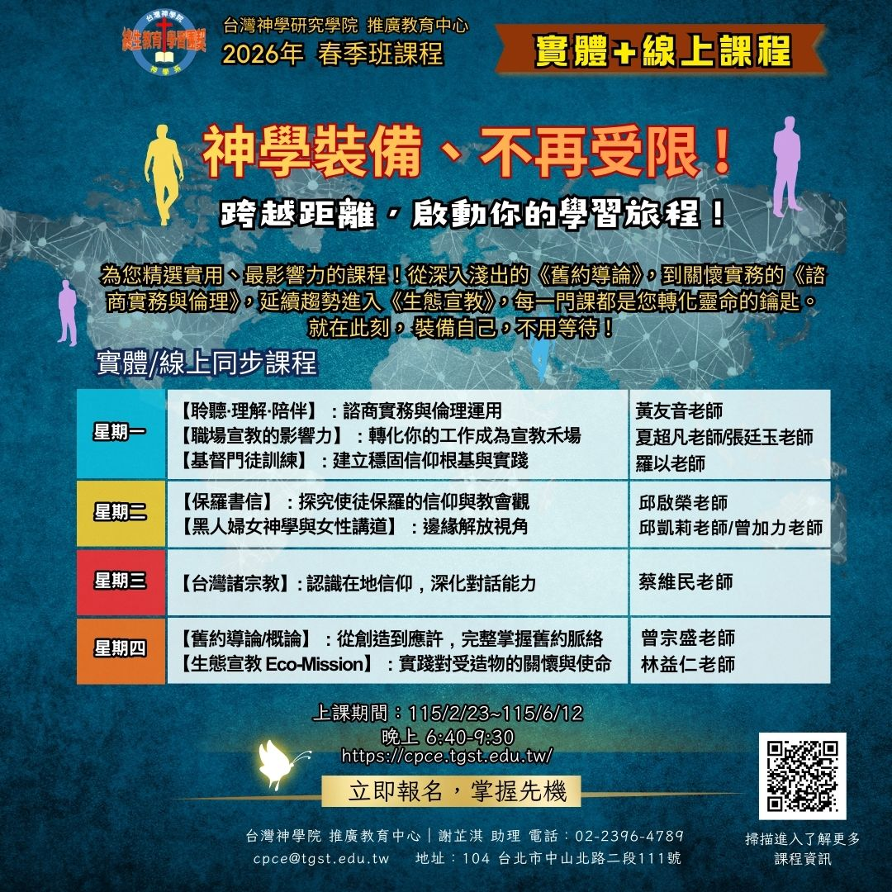

未來台神能夠回饋海外教會的事工
雙職事奉的神學教育資源
為教會安排神學、聖經及教會實務講座。
提供線上課程、密集課程或教會包班，並可取得學程學位。

Slide 19
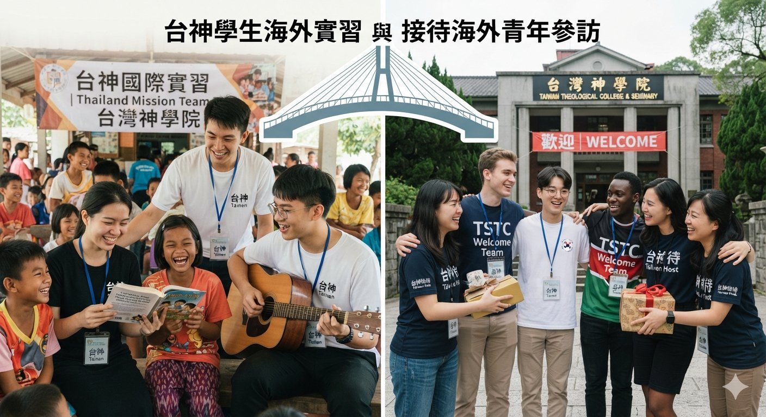
未來台神能夠回饋海外教會的事工
台神與北美教會的夥伴關係
合辦神學院之間講座、培靈會與教會領袖培訓。
安排台神學生到海外教會實習或接待海外青年到台灣參訪、短宣及學習。
建立學校進修合作平台，並連繫教會、神學院與台神間的支持網絡。

Slide 20
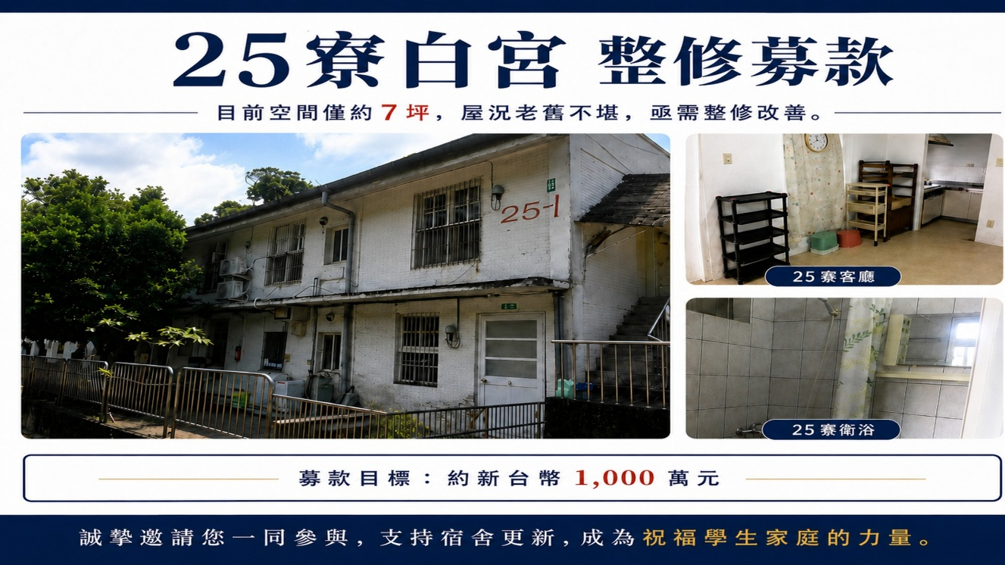

Slide 21


Slide 22
